Slide 1


Auditrix - A Curriculum Audit System for KSU
Jhonrey Binaraba
Crystel Mae Dela Cueva
Kenneth Christian Tockiapao

Slide 2
VISION AND MISSION
VISION
A globally engaged university of excellence rooted in culture and driven by innovation for sustainable and inclusive development.
MISSION
Provide quality education, innovative research, sustainable practices and culture-based community.

Slide 3

UNIVERSITY HYMN
“Let Humanity Prevail”
(Pancy Aquino & Perfecto Lazo)
KSU is the light of the vast Kalinga Province
Born encompassing with the breadth of the poor
Bringing forth a glamorous delight
To tinge the innocent mind of every child
Refrain:
Hail KSU I’ll sing you a song of praise
I cling to thy brow to sip the nectar of your ways
Flowing in thy streams of wisdom and truth
Pride of Kalinga Province walk on!
When humanity’s understanding prevails
Thy off spring would proudly stand with palms on their breast
To pour out their golden thought ablaze
Where dreams, now realities of culture and birth
(Repeat Refrain)
Flowing in thy streams of wisdom and truth
Hail, Kalinga State University walk on!

Slide 4
BACKGROUND OF THE STUDY
CHED requires state universities to uphold curriculum integrity, including prerequisite rules.
1
At KSU, prerequisites are still checked by hand by the program chairperson, even with the MIS in place.
2
Violations are often found late, at enrollment or just before graduation, delaying students and adding costs.
3

Slide 5
AUDITRIX: THE PROPOSED SYSTEM
A web-based system that checks each student's grades against their curriculum.
Detects violations
Flags prerequisite, co-requisite and year-standing violations, with the reason.
Shows what's next
Lists the subjects a student may take next and what is still needed.
Supports chairpersons and deans
Dashboards, curriculum versions, and student imports from the KSU-MIS export.

Slide 6
STATEMENT OF THE PROBLEM
What is the current process for evaluating students' prerequisite compliance with the curriculum?
1
What problems are encountered in evaluating students' prerequisite compliance with the curriculum?
2
How can a curriculum audit system be designed to ensure prerequisite compliance with the curriculum?
3
What is the level of compliance of the proposed system with the ISO/IEC 25010 software quality standards?
4

Slide 7
OBJECTIVES OF THE STUDY
To identify the process for evaluating students' prerequisite compliance with the curriculum.
1
To determine the problems encountered in evaluating students' prerequisite compliance.
2
To design and develop a system that ensures prerequisite compliance with the curriculum.
3
To evaluate the level of compliance of the system with the ISO/IEC 25010 software quality standards.
4

Slide 8
SIGNIFICANCE OF THE STUDY
Program Chairpersons
Faster, automated checking of student eligibility.
College Dean
A college-wide view of curriculum compliance.
Students
Violations caught early for on-time graduation.
Institution (KSU/CEIT)
Supports CHED and accreditation standards.
Researchers
Hands-on experience building a real system.
Future Researchers
A reference for future academic tools.

Slide 9
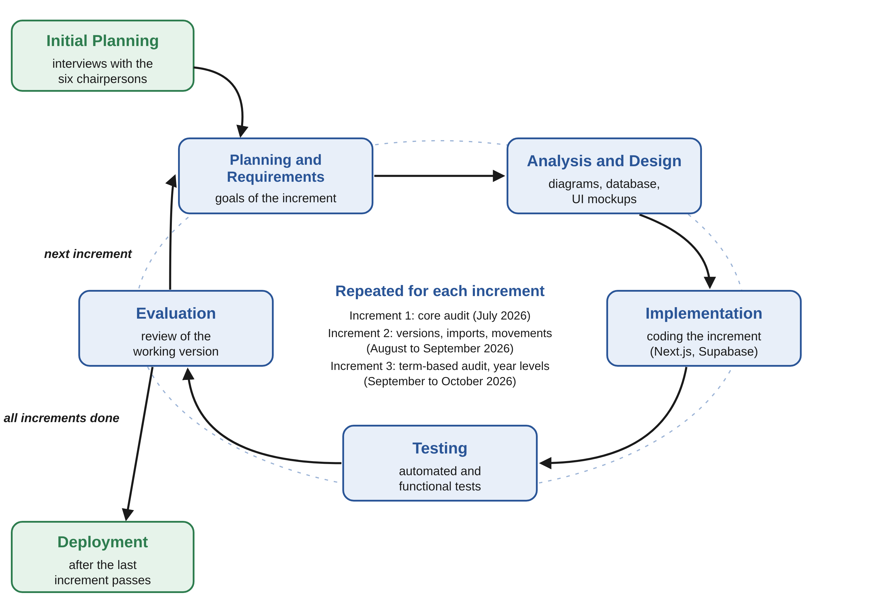
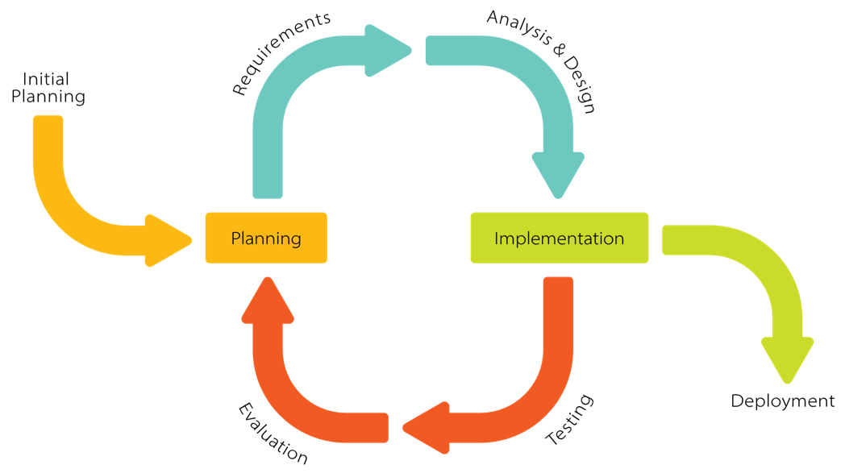
SOFTWARE DEVELOPMENT METHODOLOGY

Slide 10
LOCALE AND POPULATION
LOCALE
Kalinga State University (KSU), Main Campus, Bulanao, Tabuk City
College of Engineering and Information Technology (CEIT)
POPULATION
The six program chairpersons of the CEIT
IT experts
Students who experienced prerequisite violations

Slide 11
DATA GATHERING
Techniques
Interviews
Document analysis
Survey (ISO/IEC 25010)
System testing
Tools
Structured interview questionnaire
ISO/IEC 25010 survey questionnaire (paper-based)
Sources
Primary: chairpersons, IT experts, students
Secondary: curriculum maps, KSU Student Handbook and Operations Manual, MIS class lists

Slide 12
SOFTWARE DEVELOPMENT TOOLS
Next.js
Web framework
TypeScript
Programming language
Tailwind CSS
Design and layout
Supabase
PostgreSQL database and log in
Figma
UI design and prototypes
Node.js Test Runner and Playwright
Automated testing
Git and GitHub
Version control

Slide 13
KEY RESULTS AND FINDINGS
SOP 1
Existing process: Prerequisites are checked by hand, record by record, against the curriculum map.
SOP 2
Problems: Late detection of violations, no automated checking tool, and limited student awareness.
SOP 3
Proposed system: Auditrix checks every subject term by term and gives each one a status: Completed, Available, INC, Unavailable, or Violation.
SOP 4
ISO/IEC 25010: Overall weighted mean of 4.48, interpreted as Very Great Extent.

Slide 14
ISO/IEC 25010 EVALUATION RESULTS
Characteristic | Weighted Mean | Description
Functionality | 4.50 | Very great extent
Efficiency | 4.33 | Very great extent
Compatibility | 4.60 | Very great extent
Usability | 4.37 | Very great extent
Reliability | 4.48 | Very great extent
Security | 4.44 | Very great extent
Maintainability | 4.52 | Very great extent
Portability | 4.57 | Very great extent
Safety | 4.50 | Very great extent
Overall | 4.48 | Very great extent
4.48
Overall weighted mean
Very Great Extent
Highest: Compatibility (4.60)
Lowest: Efficiency (4.33)

Slide 15
CONCLUSIONS
The existing curriculum audit is manual and prone to human error.
1
Violations are found late because nothing checks grades against the curriculum before enrollment.
2
Auditrix flags violations as soon as grades are entered, before enrollment instead of at graduation.
3
Auditrix complies with ISO/IEC 25010 to a very great extent (4.48).
4

Slide 16
RECOMMENDATIONS
Deploy Auditrix on a hosted online server.
Connect Auditrix directly with the KSU MIS.
1
5
Improve user error protection.
Add a student view for self-auditing.
2
6
Optimize performance for larger student populations.
Explore predictive analytics in future studies.
3
7
Expand to the other KSU colleges.
4

Slide 17
THANK YOU FOR YOUR TIME, MA’AMS AND SIR!

